Slide 1
CSE 4102 Computer Graphics and Image Processing Laboratory Week 3: Image Restoration
Md Tajmilur Rahman
Lecturer
Dept. of CSE, KUET
Md Mubtashim Abrar Nihal
Lecturer
Dept. of CSE, KUET

Slide 2
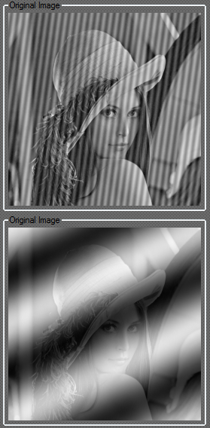
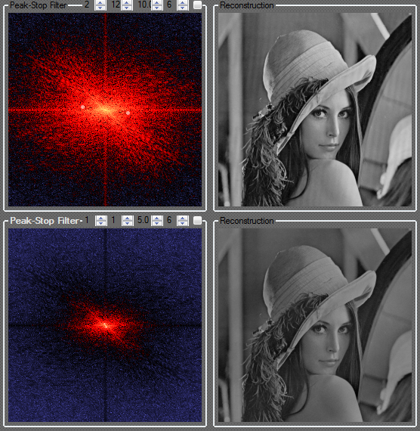
What We are Going to Do Today?
Transform the image from spatial domain to frequency domain
Find the frequency of the periodic noise
Remove that frequency
Reconstruct the image from frequency domain to spatial domain

Slide 3
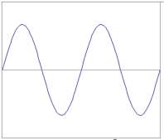



Examples
Spatial domain visualization
Frequency domain visualization
1D
2D
What do the three dots correspond to?

Slide 4
Examples
Spatial domain visualization
Frequency domain visualization
?

Slide 5
2D DFT
a-periodic signal periodic transform
Forward transform
Inverse transform:
u, v : the transform or frequency variables
x, y : the spatial or image variables
periodized signal periodic and sampled transform

Slide 6
2D Discrete Fourier Transform
Represents an image in a frequency domain where the original image is represented in a spatial domain.
2D DFT converts an image into a complex array that consists of :
Power Spectrum
Phase Angle

Slide 7
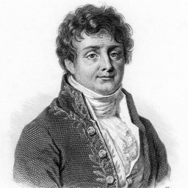
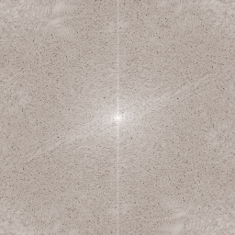
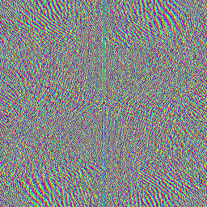
Magnitude and Phase of DFT
What is more important?
Hint: use the inverse 2D DFT to reconstruct the input image using only magnitude or phase information.
magnitude
phase

Slide 8
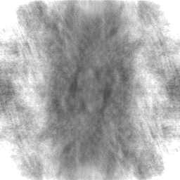
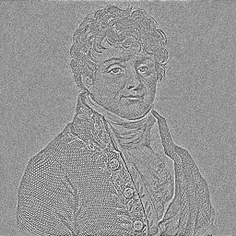
Magnitude and Phase of DFT (cont’d)
Reconstructed image using magnitude only
(i.e., magnitude determines the
strength of each sinusoidal component)
Reconstructed using phase only
(i.e., phase determines
the phase of each sinusoidal component)

Slide 9
Fourier Transform

Slide 10
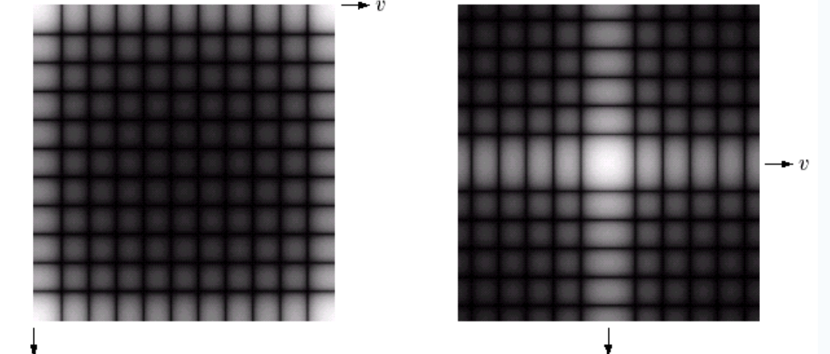
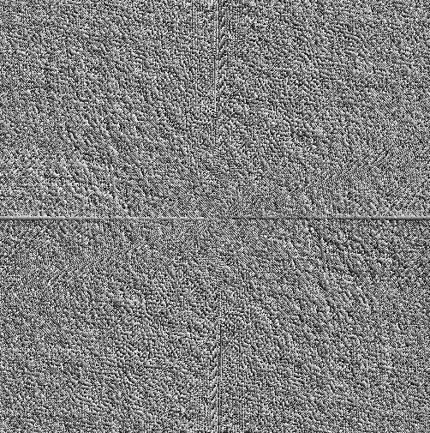
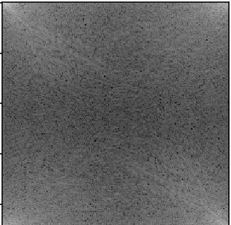
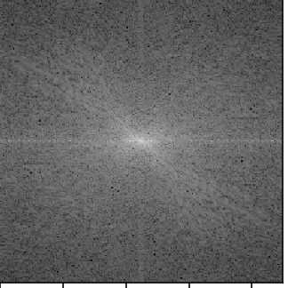
Basics of Filtering in the Frequency Domain
Phase
Spectrum moved into the centre

Slide 11
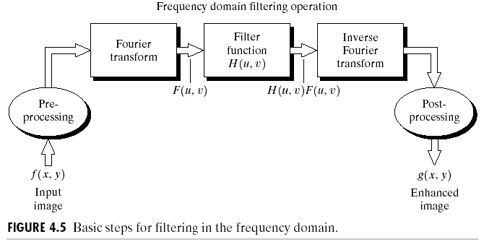
Basics of Filtering in the Frequency Domain
To filter an image in the frequency domain:
Compute F(u,v) by DFT of the image f(x,y).
Multiply F(u,v) by a filter function H(u,v).
Compute the inverse DFT of the result .

Slide 12
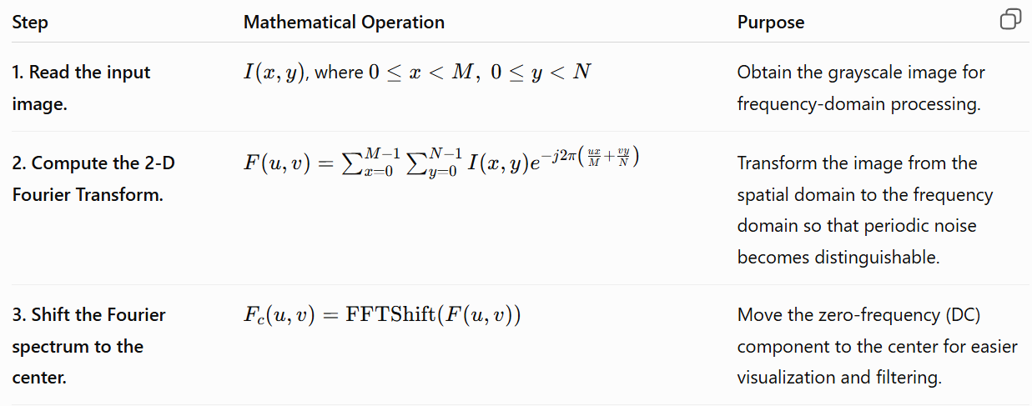
Steps

Slide 13
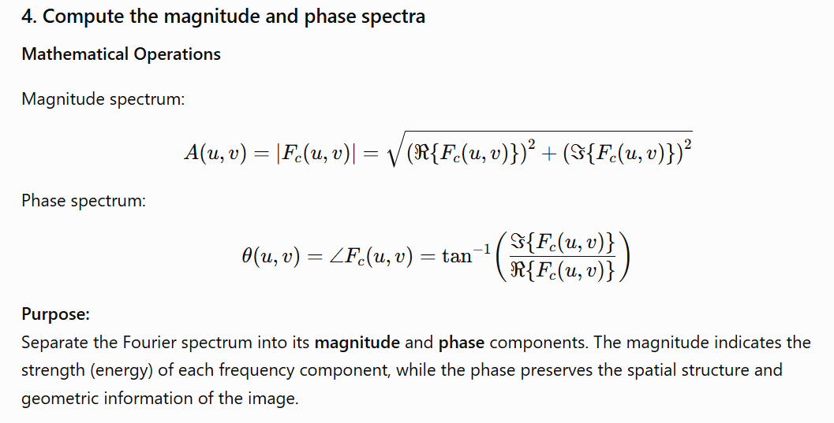
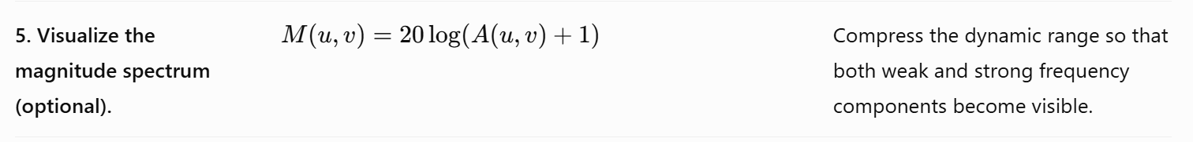
Steps

Slide 14
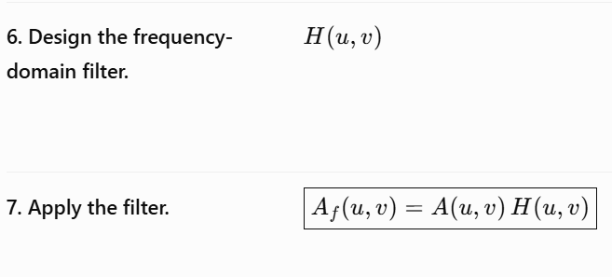
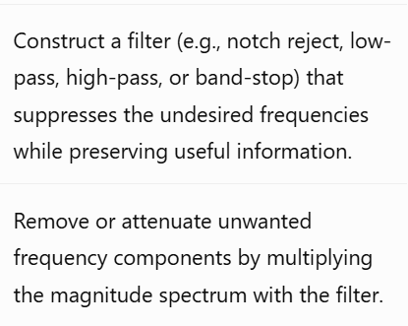
Implement These Steps

Slide 15
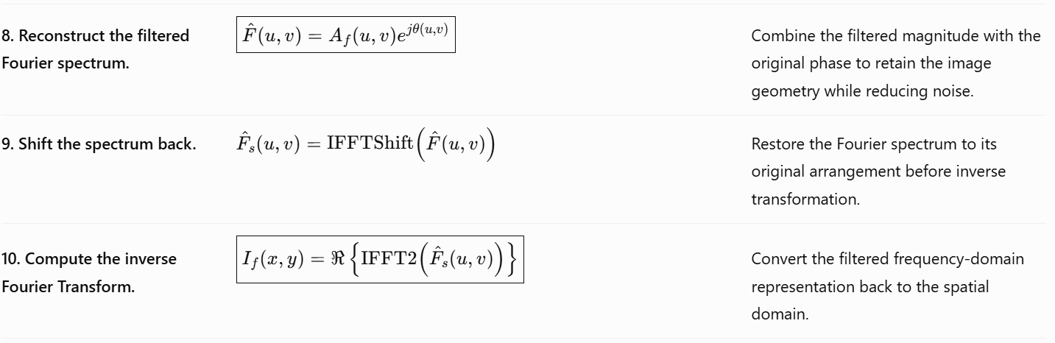
Steps

Slide 16

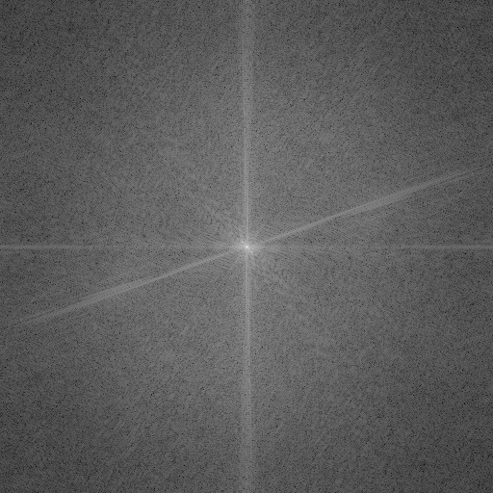
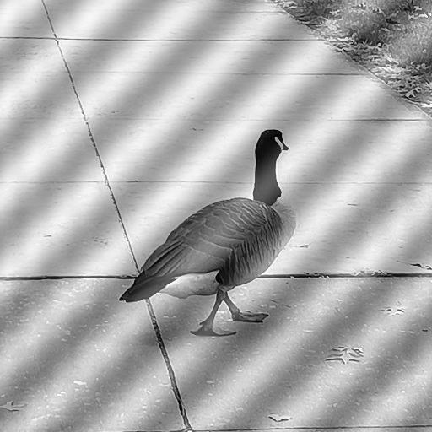
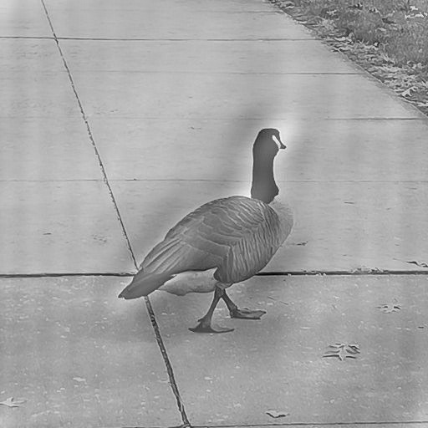
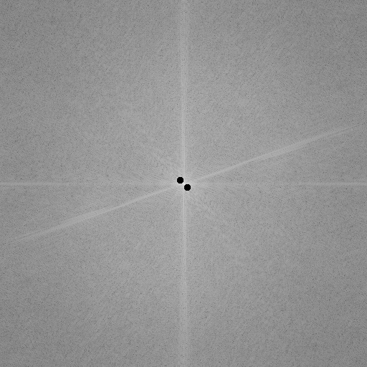
Example
Power spectrum
Notch filter
phase

Slide 17
Notch Filter
A notch filter rejects (or passes) frequencies in a predefined neighborhood about the center of the frequency rectangle.
A notch is symmetric about the origin (center of the frequency rectangle)
One with center at (u₀, v₀) must have a corresponding notch at location (-u₀, -v₀)

Slide 18
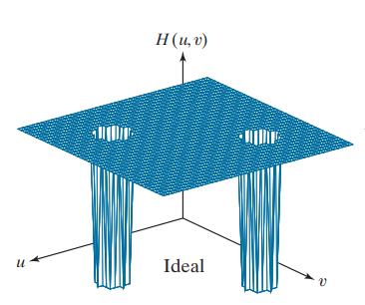
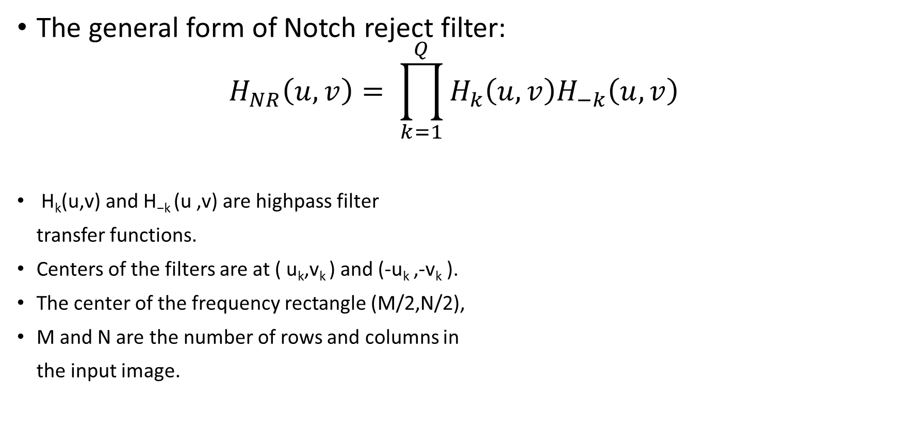
Ideal Notch Reject Filter
The general form of Notch reject filter:
$$H_{NR}\left(u,v\right)= \prod_{k=1}^{Q}{H_{k}\left(u,v\right)H_{−k}\left(u,v\right)}$$
H_{k}(u,v) and H_{−k} (u ,v) are highpass filter
transfer functions.
Centers of the filters are at ( u_{k},v_{k} ) and (-u_{k} ,-v_{k} ).
The center of the frequency rectangle (M/2,N/2),
M and N are the number of rows and columns in
the input image.

Slide 19
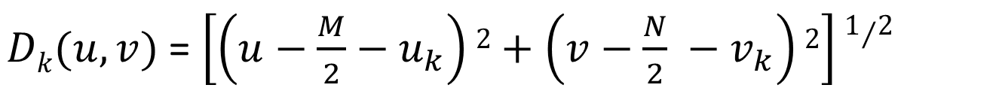
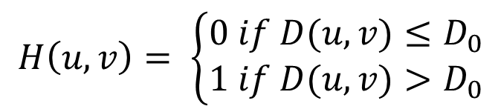
Ideal Notch Reject Filter
The general form of Ideal High-pass filter where D0 (the cut off frequency) is the radius of the notch
The distance computations for each filter transfer function are given by
$$H\left(u,v\right)= \left\{\begin{aligned}0 if D(u,v)≤D_{0} \\ 1 if D(u,v)>D_{0}\end{aligned}\right.$$
$Dk(u,v)$ = $\left[\left(u−\frac{M}{2}−u_{k}\right)2+\left(v−\frac{N}{2} −v_{k}\right)2\right]1/2$
$D−k(u,v)$ = $\left[\left(u−\frac{M}{2}+u_{k}\right)2+\left(v−\frac{N}{2}+v_{k}\right)2\right]1/2$

Slide 20
Classwork
Take an input grayscale image and apply Notch reject filters on the Fourier domain to remove periodic noise from the image.
Compute DFT F(u,v) for the input image.
Show the power spectrum of F(u,v)
Select the coordinates from the spectrum which you want to remove.
Generate the Notch reject filter around the coordinate(= center) to reject that specific frequency as H(u,v). The radius of the Notch will be user input. Show H(u,v).
Form the product G(u,v) = F(u,v)H(u,v).
Apply Inverse Fourier Transform to generate the output image in the spatial domain.

Slide 21
Classwork
Power spectrum
Notch filter
phase

Slide 22
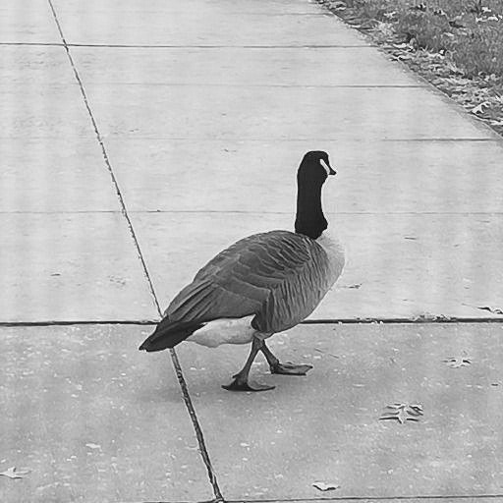
Classwork
Removing frequency at (u,v)= (261,261) , D0 = 1
Removing frequency at (u,v)= (261,261) , D0 = 5
Input image

Slide 23
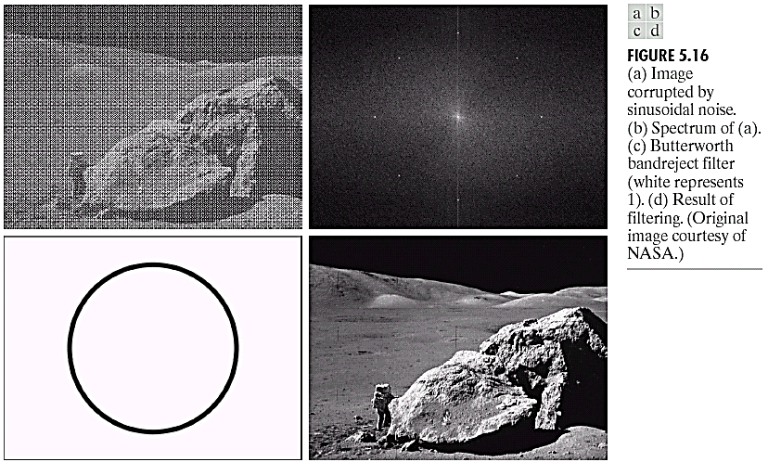
Assignment: Band Reject Filters

Slide 24
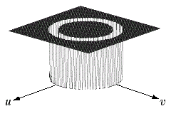
Ideal Band Reject Filter
-D(u,v) =distance from the origin of the centered freq. rectangle
-W =width of the band
-D₀=Radial center of the band.

Slide 25
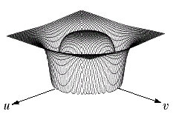
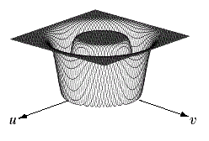
Butterworth and Gaussian Band Reject Filters
Butterworth Band-Reject Filter of order n
Gaussian Band-Reject Filter

Slide 26
Output Format
Input Corrupted Image with noise | Filters | Reconstructed Image after applying filter
Input Image | Ideal Band Reject Filter | Reconstructed Image
Input Image | Butter worth Band Reject Filter | Reconstructed Image
Input Image | Gaussian Band Reject Filter | Reconstructed Image

Slide 28
References
https://www.amritaryal.com.np/posts/categories/mathematics-and-engineering/2.html
https://contra.medium.com/drawing-anything-with-fourier-series-using-blender-and-python-c0881e1b738c

